Slide 1
Kaggle competition: Object Detection and Classification
Team Name: Night Owls
EE20B027 C Shravan
EE20B006 A Raghavendra
CH21B033 Sameer Deshpande

Slide 2
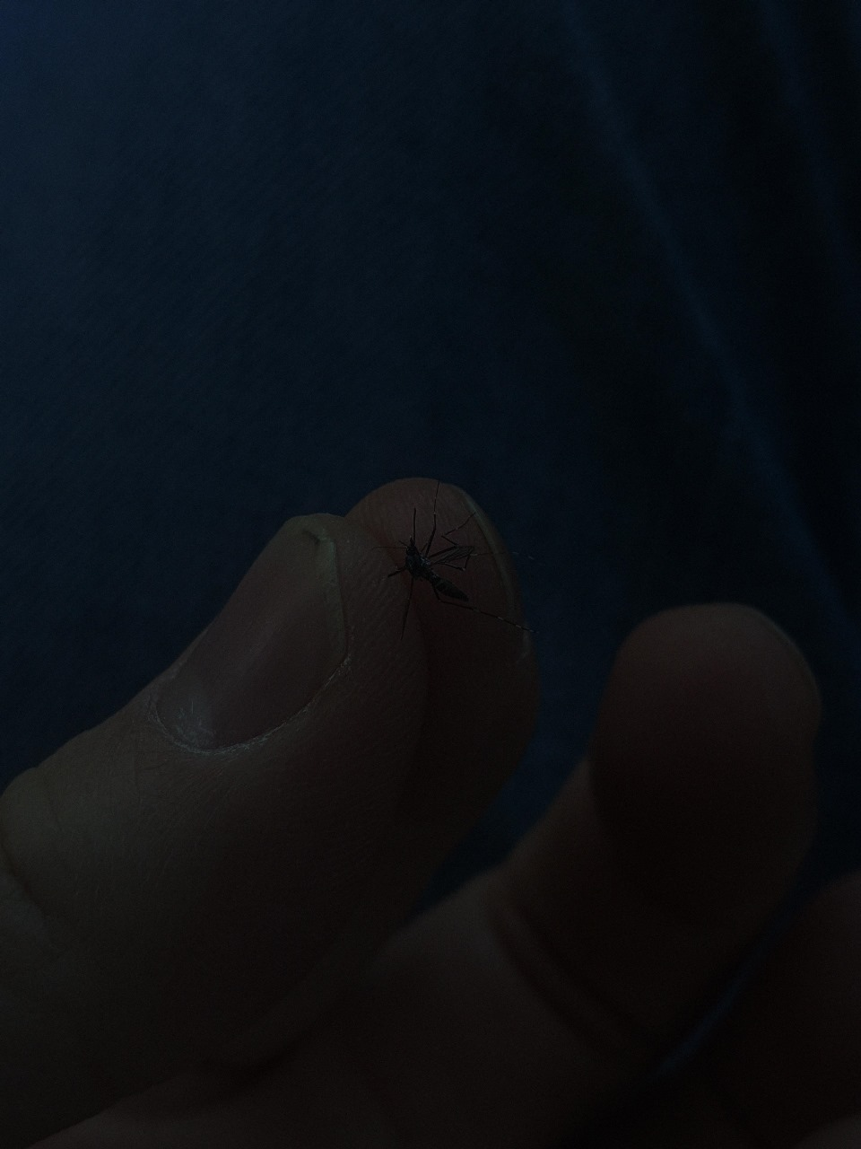
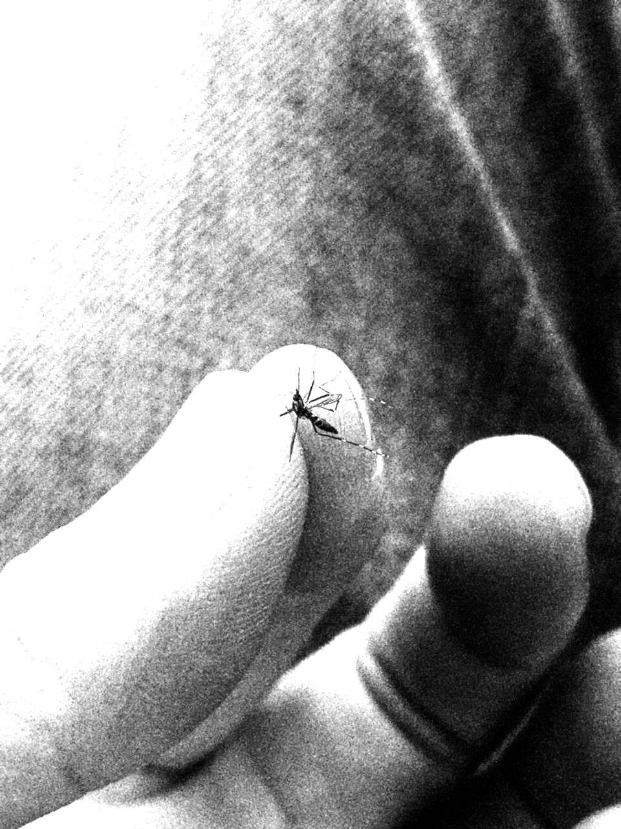
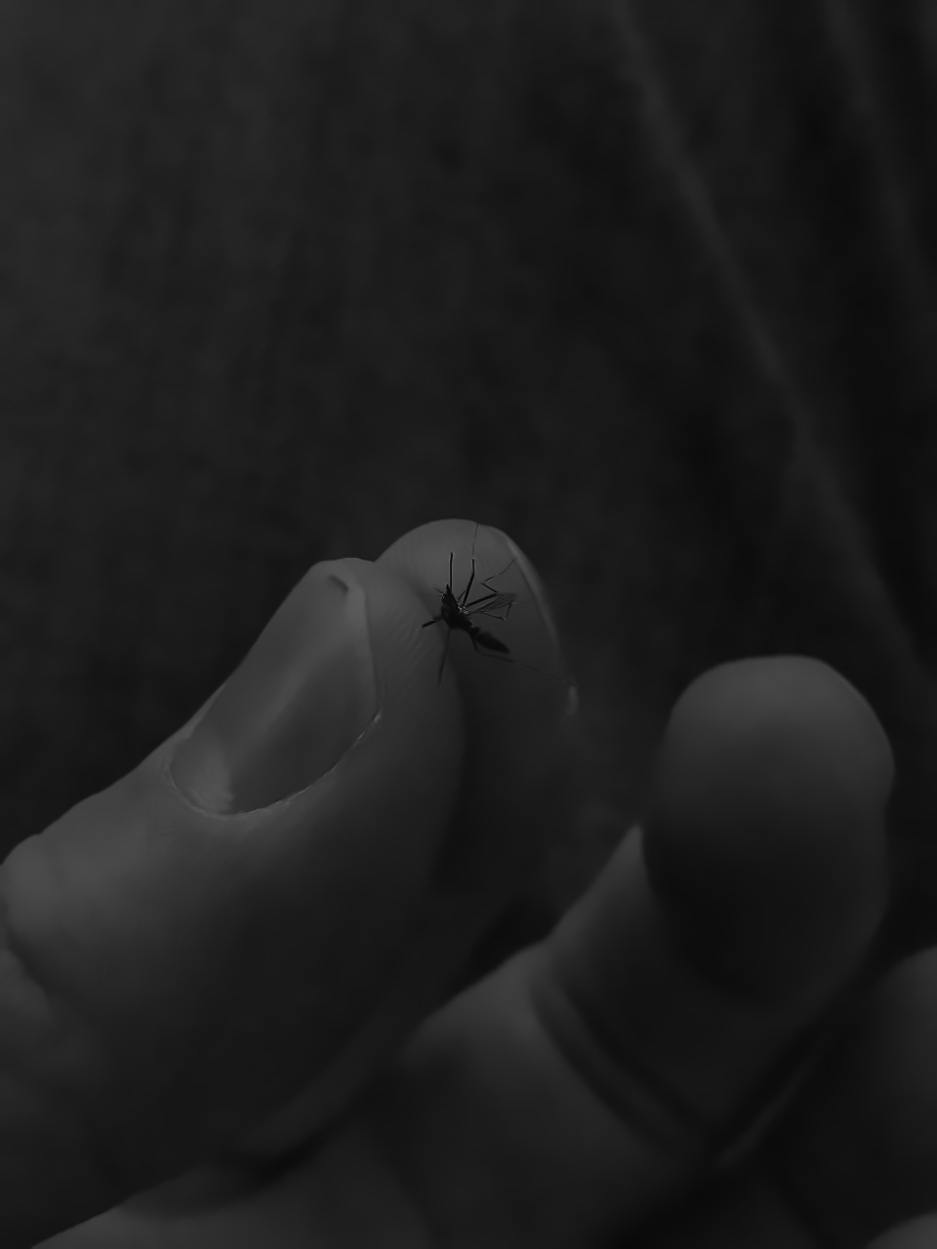
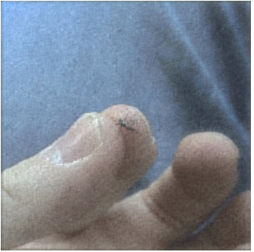
Architectures we tried for object detection
We have tried YOLO V8 and Faster R-CNN
Trained the models with enhanced images done using CLAHE, gamma correction and Deep Learning Based MIRNET
Original Image Gamma Correction-(1.5) Clahe image MIRNET image
mAP Score 0.40 0.52 0.55 0.60

Slide 3
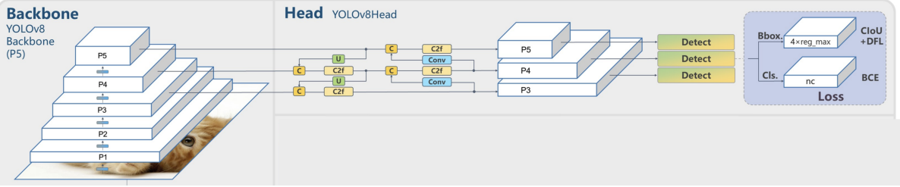
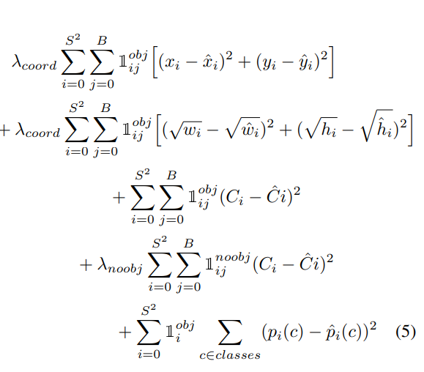
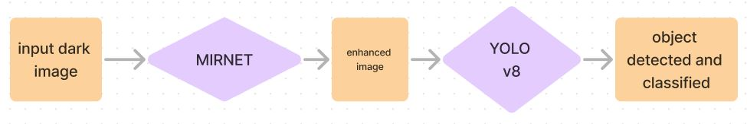
Image enhancement through MIRNET and YOLO V8 object detection
YOLO V8 model architecture :
Loss function of YOLO V8:
Localization loss + Cross entropy
Epochs : 50
Batch size : 128
Optimizer : Adam (momentum)
Learning rate : 0.001-0.005

Slide 4
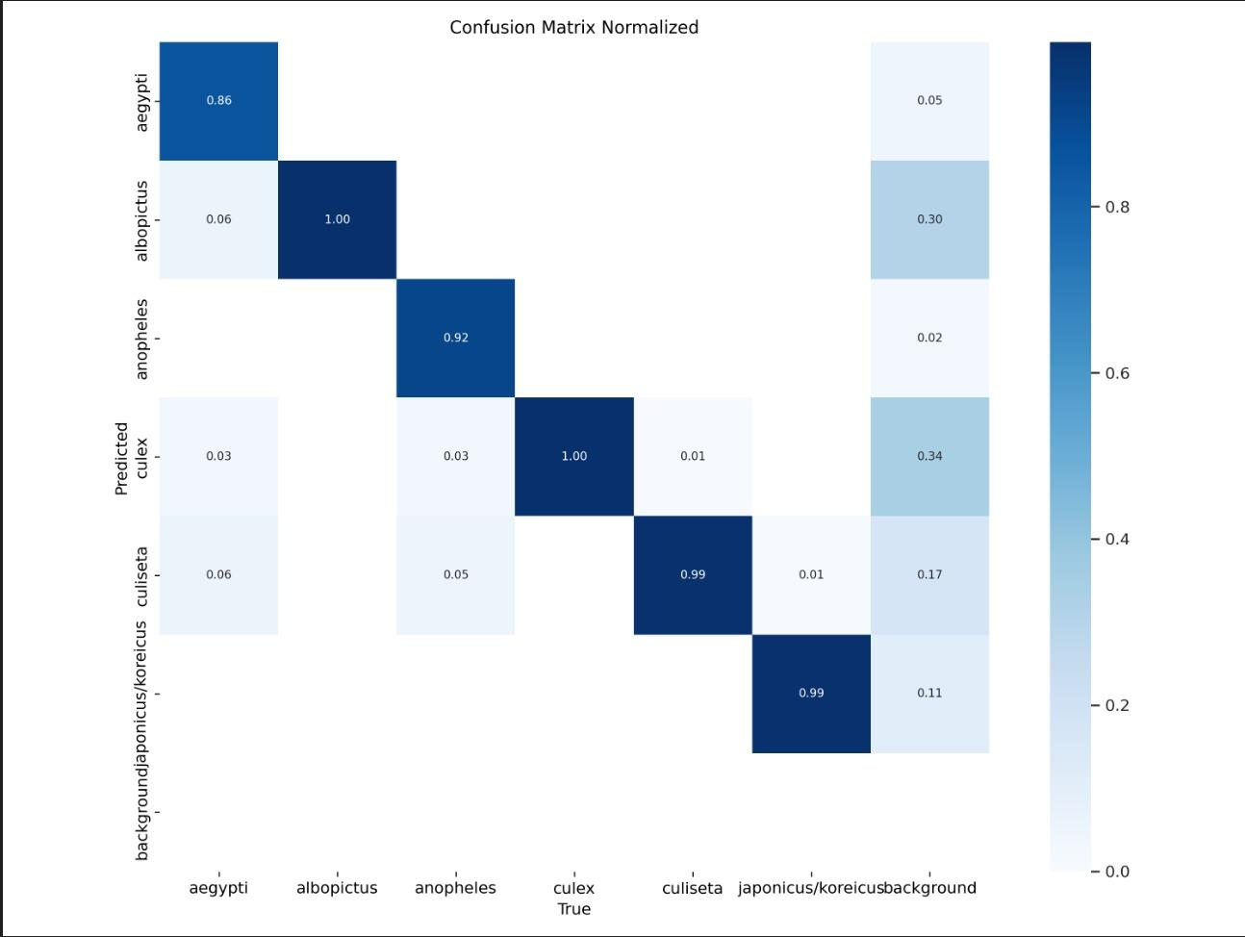
Dataset Information
Total classes : 6
Count of individual train dataset
{‘0’ : 35, ‘1’ : 3324, ‘2’ :59, ‘3’ :3312, ‘4’ :460, ‘5’ : 300}
Through the predictions we observed the class imbalance which
Lead to biased results.
DATA Augmentation Techniques (For Class Imbalance) :
Horizontal/Vertical Flip, Rotation, Scaling.
Adding contrast, Brightness gave good variations and it helped
from overfitting towards specific class.

Slide 5
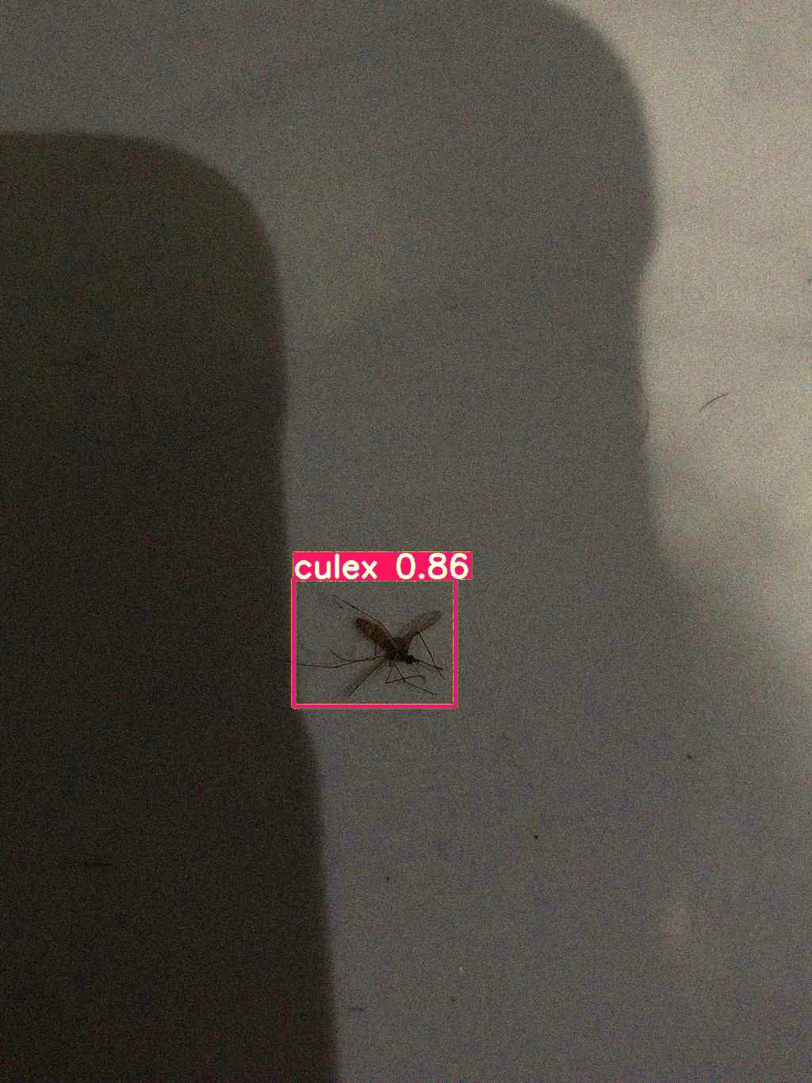
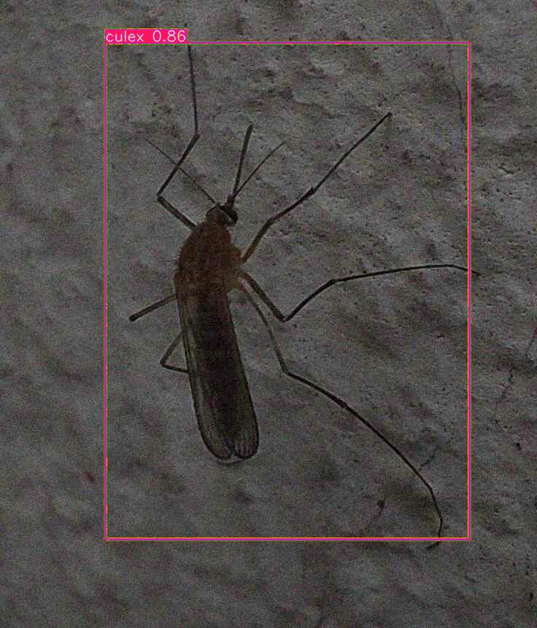
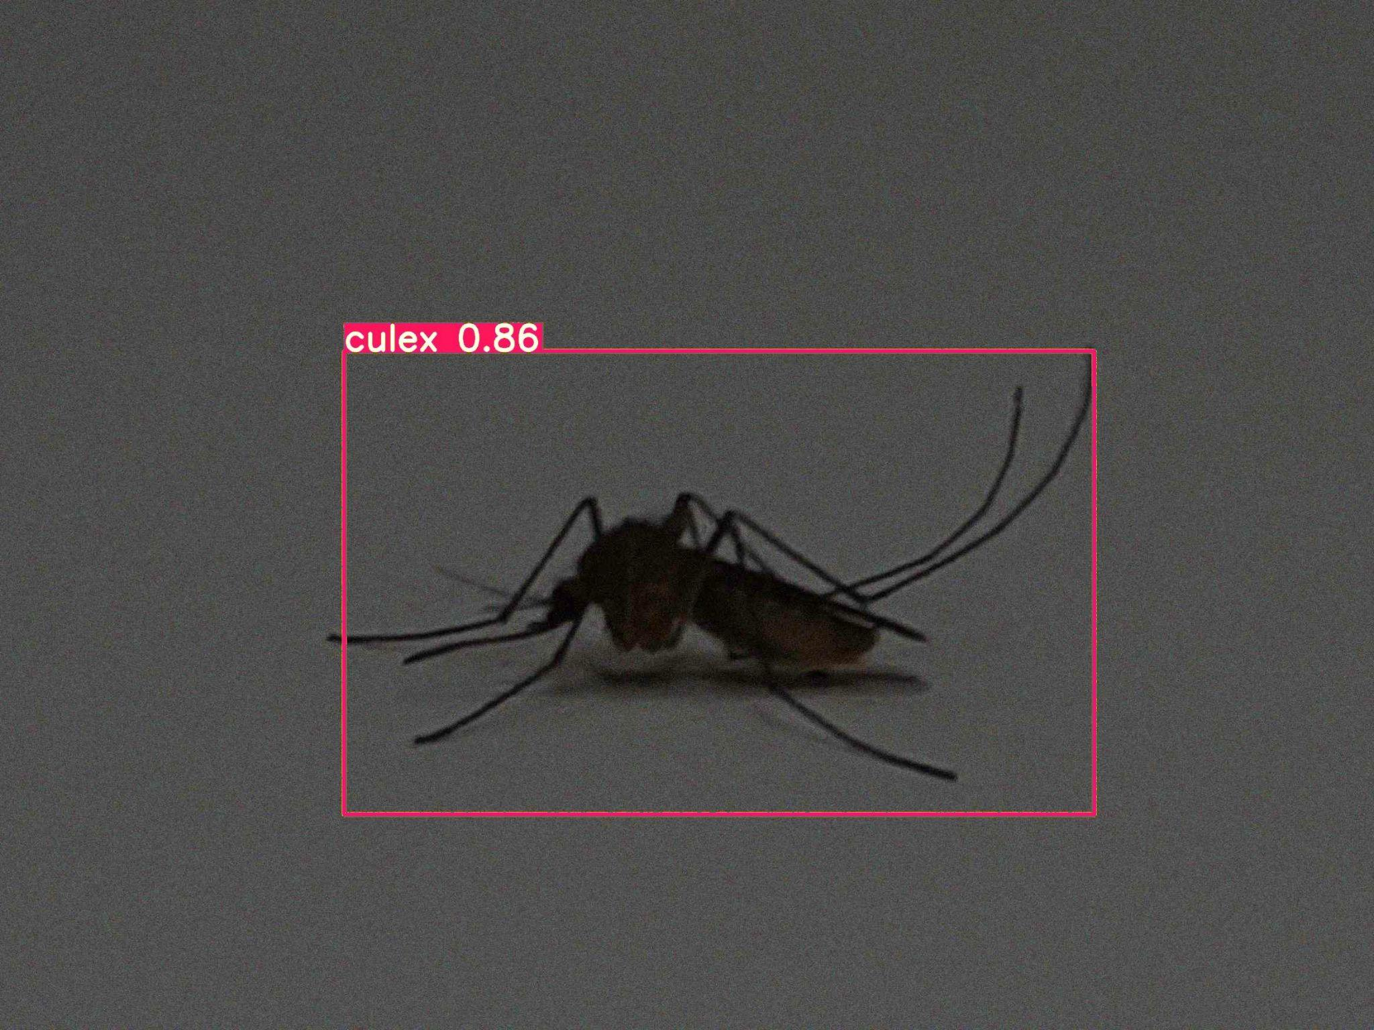
Correct classifications on training data

Slide 6
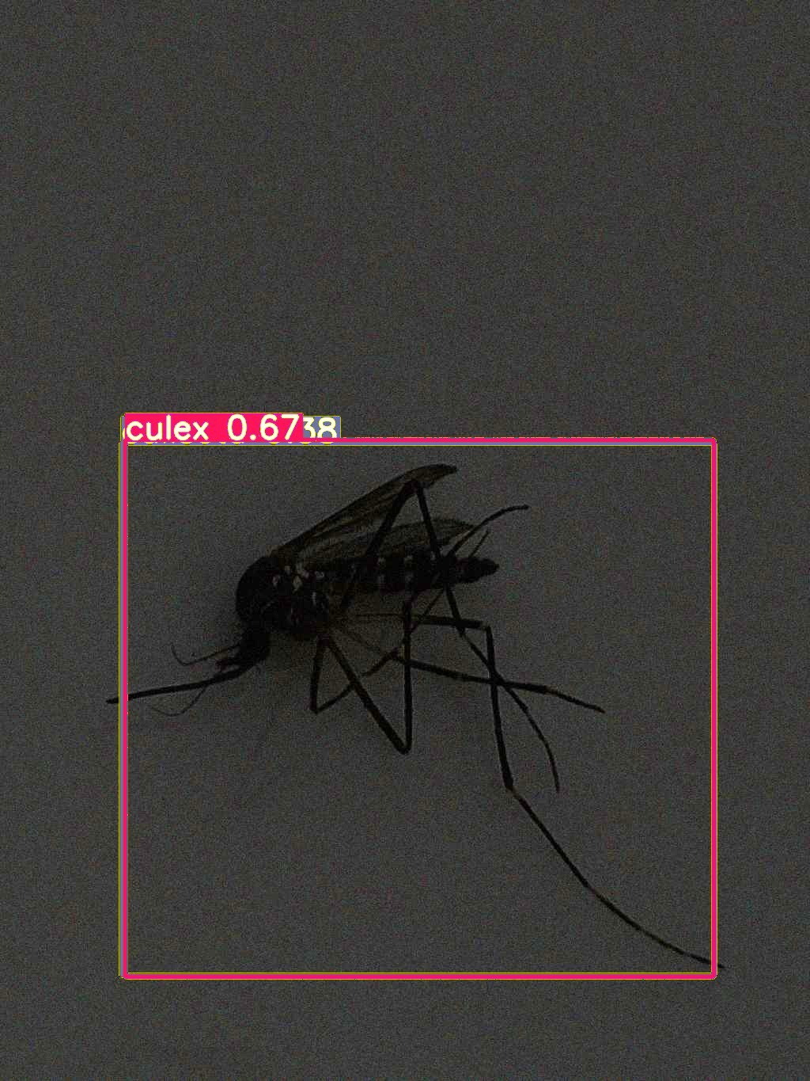
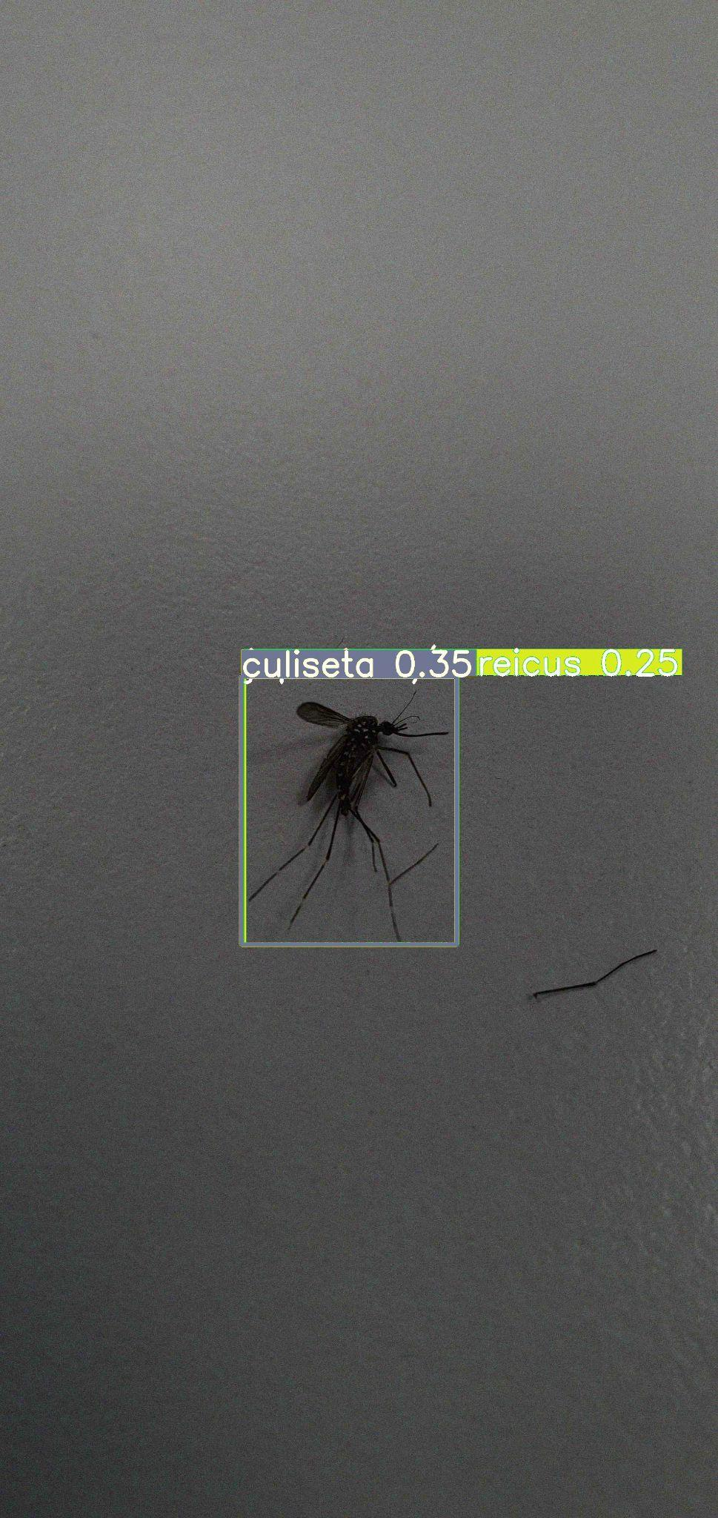
Wrong Classification of train images

Slide 7
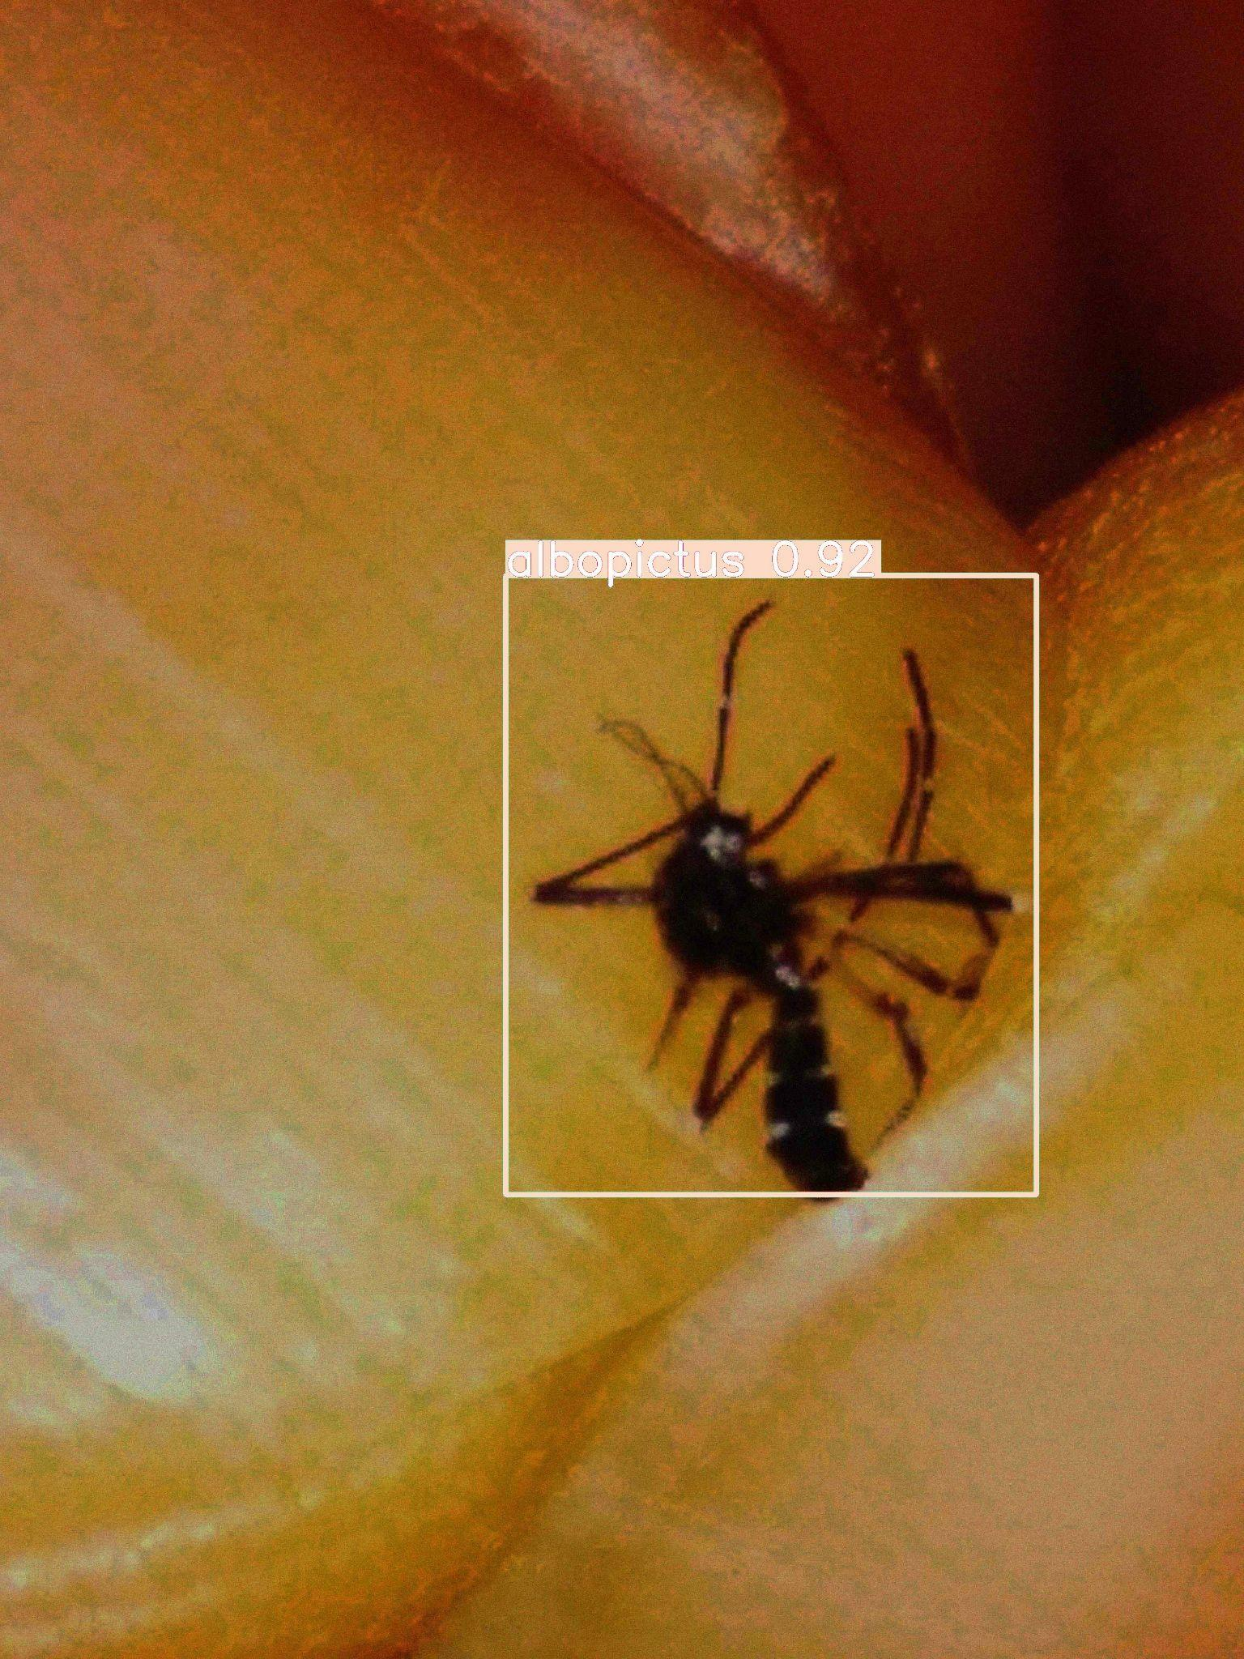
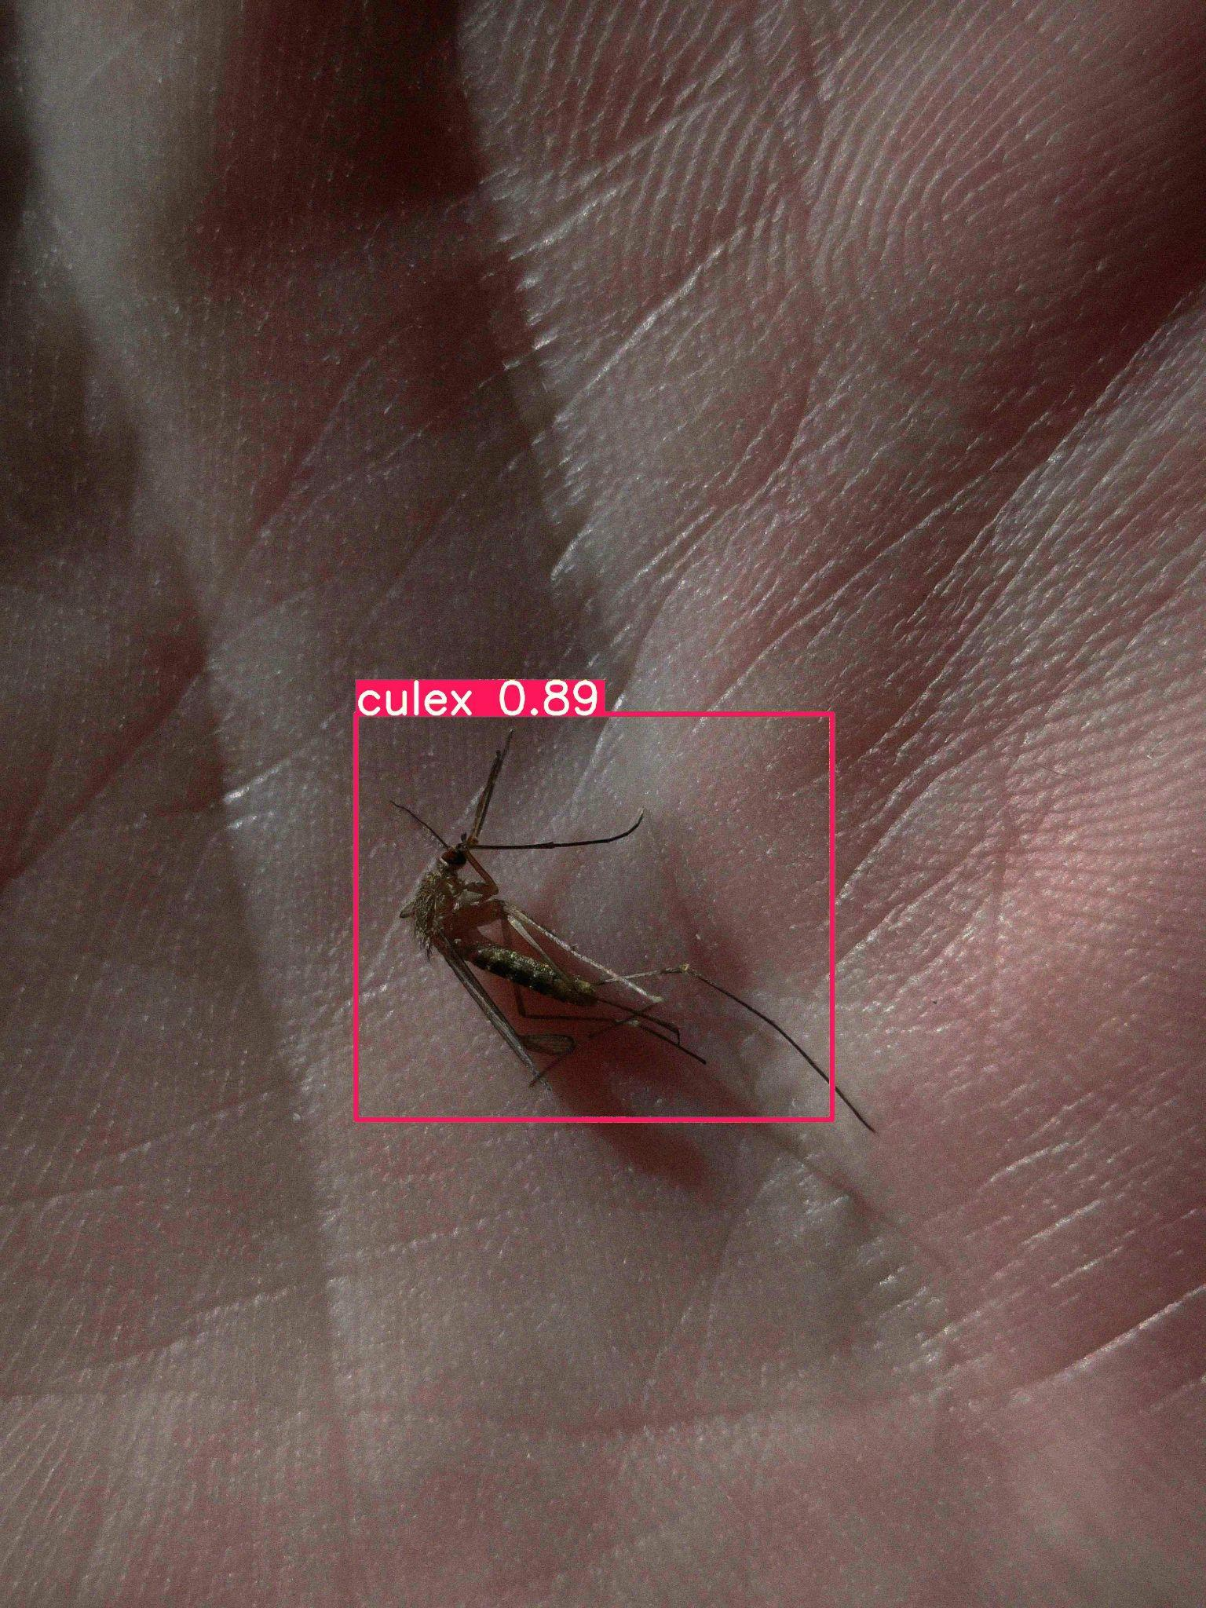
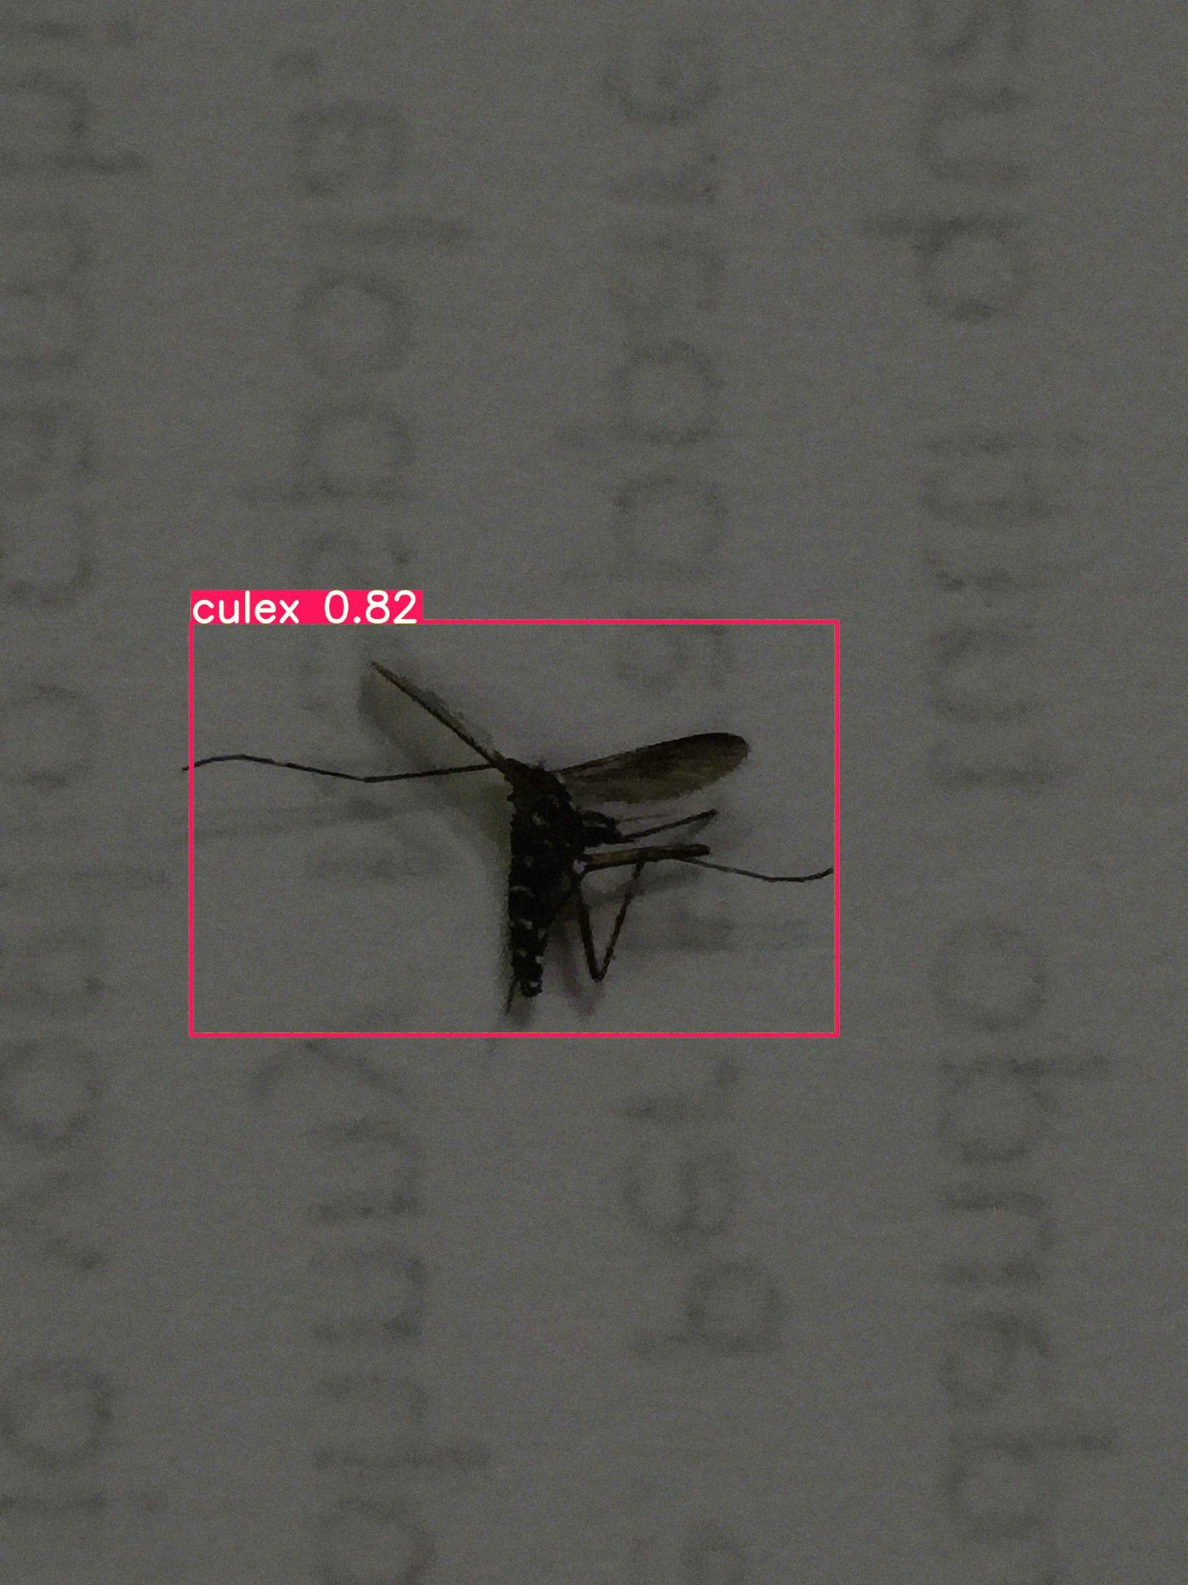
Predicted Results on Test data
Predicted class : albopictus culex culex

Slide 8
Individual contributions
Sameer Deshpande: Worked on MIRNET preprocessing , YOLO V8
A Raghavendra : Gamma correction , RCNN architecture ,Data Augmentation ,
C Shravan : Clahe , Transfer learning in YOLO V8 architecture
References :
YOLO research paper : https://arxiv.org/abs/1506.02640
Mirnet model from keras : https://keras.io/examples/vision/mirnet/
Kaggle Leaderboard
Position : 19
Kaggle score : 0.467

